Slide 1
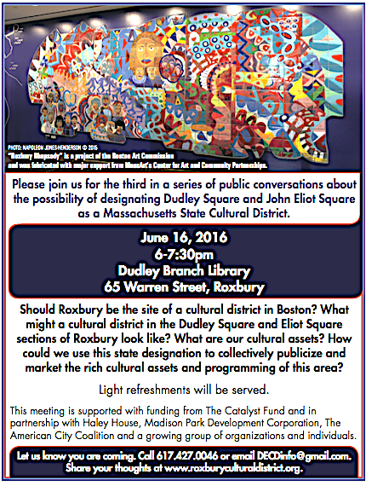
DUDLEY SQUARE-ELIOT SQUARE CULTURAL DISTRICT

Slide 2
(
DUDLEY SQUARE-ELIOT SQUARE CULTURAL DISTRICT
Agenda
Update
Vision Statement Draft
Mission Statement Draft
Strategies & Goals
Mapping Tool
Governance
Next Steps
Notes:
Our Agenda:
-Welcome & Introductions: We know that Byron Rushing will be there and he and other public officials should be formally acknowledged. Also acknowledge Kara Eliot-Ortega from Office of Arts & Culture if she attends. Others that need to be acknowledged? I do like the idea of having everyone quickly say their name and affiliation, if the group is not too large and people don’t start adding more than that.
-A Brief History CR NOTE: I think that we need this to be a bit scripted so we get it right. Maybe here, the focus should be on the cultural district legislation. This was in the RFP and in the grant application. MCC Cultural District Initiative was authorized by an act of the MA state legislature in 2010 and started in April 2011. According to MCC, this program is built on the evidence that a thriving creative sector is one of our Commonwealth's most powerful economic development assets. Since that time, 32 communities across the state have been designated cultural districts including two in Boston: Fenway Cultural District and the Literary Cultural District. In Roxbury, several community stakeholders, including the RNC and Common Thread Coalition and many of you here tonight, have discussed and taken some steps toward seeking this designation for Roxbury. So, I like the idea of talking about it as a relaunch.
Could then add this part now, or find a place for it later: Across the state, cultural districts have brought together organization into collaborative governance structure so they can work together effectively to brand and market their cultural assets and set goals that respond to community need. In August 2015, HH, MPDC, and TACC (orgs that had worked together on the neighborhood component of the Whittier Choice Neighborhood Initiative) started to come together for biweekly conversations.. Initially, we sought to apply for an NEA Our Town grant for place-making activities on Ruggles Street. When that did not move forward, we started to think about the relationship between arts and culture and community planning in Roxbury. In the Fall of 2015, we looked at best practices in cultural districts across the country, conducted interviews with cultural districts in Boston and across the state, and applied for funding. We were fortunate to very quickly receive $25K from The Catalyst Fund (pooled funding from The Boston Foundation, the Kresge Foundation, The Hyams Foundation, and the United Way). Interestingly that The Catalyst Fund was set up to help nonprofits create strong joint ventures. So while tonight you see the logos of HH, MPDC, and TACC attached to this project, we hope that this is the last time you will see just three organizations and this will expand rapidly and that many of you and your organizations will lend your time, energy in resources to this collaborative effort.
-Our Process: I made a four pronged approach: Community Engagement, Cultural Assets and Mapping (and other benchmark data), Identifying Goals, and Shared Governance.
-Next Steps

Slide 3
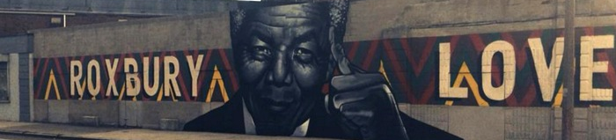
(
DUDLEY SQUARE-ELIOT SQUARE CULTURAL DISTRICT
Community Engagement
June 16 (today), Dudley Library
City Council Hearing, TBD
MCC Tour, TBD
Submit application to MCC

Slide 4
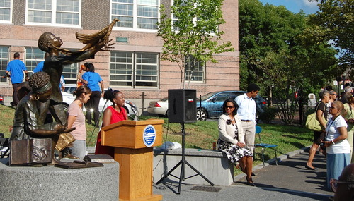
(
DUDLEY SQUARE-ELIOT SQUARE CULTURAL DISTRICT
Draft Vision Statements
To lift up the community of Roxbury as a living repository of arts and cultural expression - past, present, and future.
Roxbury is a unique community of people that appreciates its cultural assets, both people and places, in support of a thriving cultural sector that values all history and builds economic opportunities for all residents and stakeholders.

Slide 5
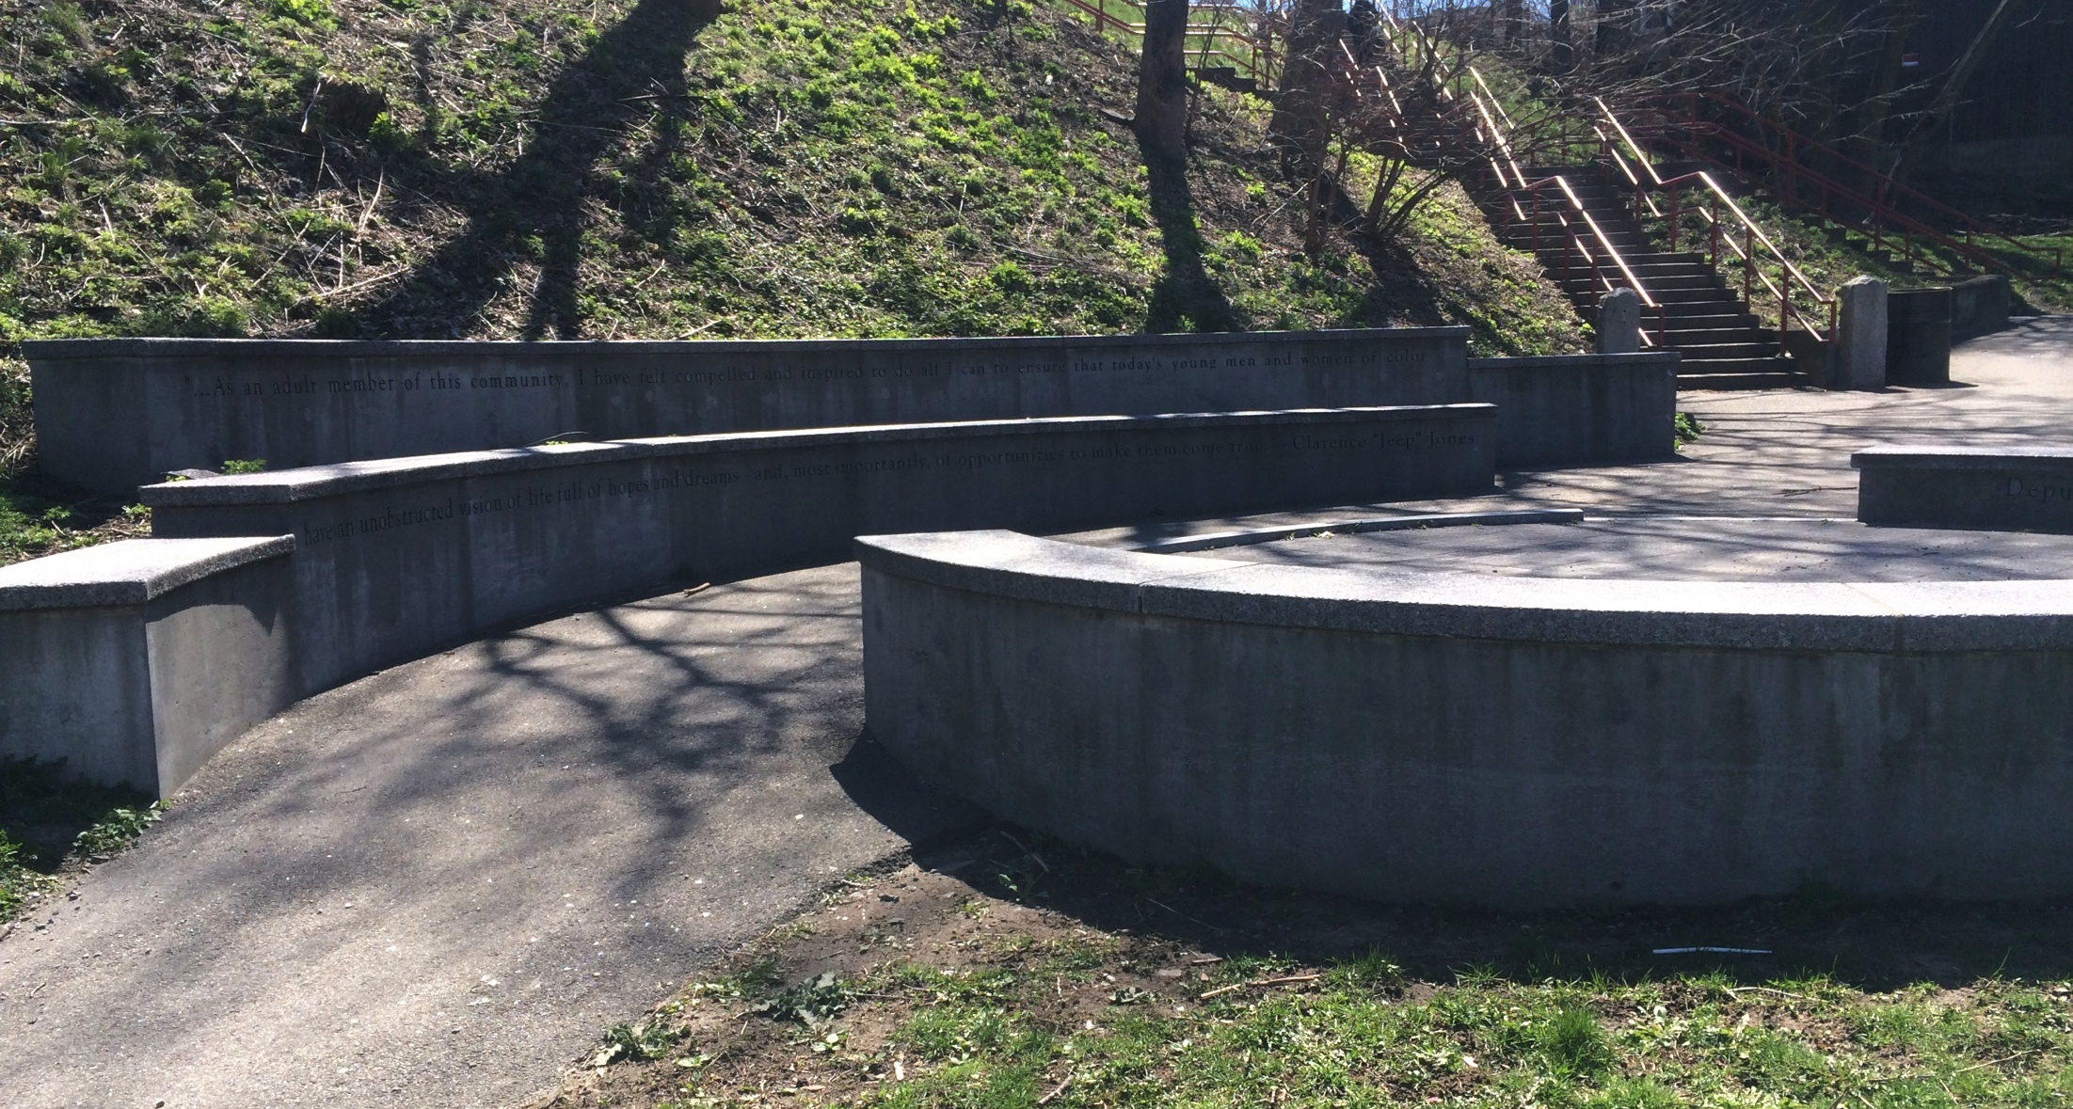
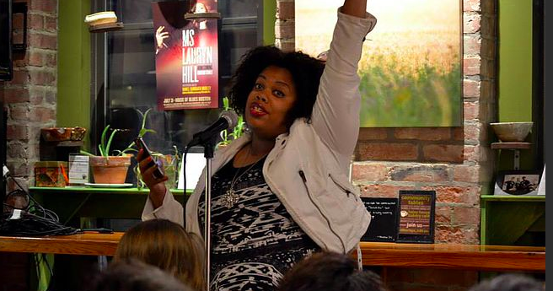
(
DUDLEY SQUARE-ELIOT SQUARE CULTURAL DISTRICT
Draft Mission Statement
To build and maintain a cultural district that identifies and recognizes Roxbury's cultural assets and establishes the tools, strategies, resources and spaces needed to sustain and grow the district's activities.

Slide 6
(
DUDLEY SQUARE-ELIOT SQUARE CULTURAL DISTRICT
(
Identifying Goals
MCC defines their goals as:
attract artists and cultural enterprises
spark business and job development
attract tourists
preserve and reuse historic buildings
enhance property values
foster local cultural development
*How can we work together to establish goals for Roxbury?

Slide 7
(
DUDLEY SQUARE-ELIOT SQUARE CULTURAL DISTRICT
Question: How do we communicate our cultural treasures from the inside out?
Answers: Recommended strategies included:
Youth Participation: Utilize summer works programs for training opportunities as neighborhood guides and ambassadors similar to MYTOWN.
Technology: Connect the district and people through technology—holograms and phone apps.
Streaming Roxbury Radio: Develop streaming radio to share spoken word, music, oral history, local news source, and cultural information.
Events and Programming: Develop consistent larger monthly events. Promote weekly events focused on film, dance, ethnic foods, etc. Maintain shared calendar so someone can look quickly and know what is going on.
Branding and Marketing: Brand district as inclusive and communicating the Roxbury art and cultural experience by stretching the boundaries and articulating a strong message that is welcoming to all. Need for a good, broad definition so that no one is excluded.
Roxbury Memory Trail: Support and learn from this related effort that is marking sites and preserving memories related to important twentieth century places and events in Roxbury.
Boston Jazz Heritage Trail: Support and learn from this related effort that is highlighting important places in Roxbury related to jazz.
History of African Americans in Boston: African Americans in Boston: More Than 350 Years documents the long and rich history of African Americans in Boston. With each new generation the information must be communicated.
Community Resources: Make use of community resources, both human, organizational, and archival.
Artists: Foster art and artists with city investments. Exhibit and share knowledge of arts in Roxbury.
Look Broadly and Deeply at Cultural Assets: Look deeply at assets to highlight the richness: Elma Lewis’ playhouse in the park; Puddingstone foundations and churches.
Mapping Assets: Conduct a survey to explore the question, “What are the most important historic cultural places and institutions?” Should not be bound by map as maps are fluid—the MFA and Gardner Museum used to be in Roxbury.

Slide 8
(
DUDLEY SQUARE-ELIOT SQUARE CULTURAL DISTRICT
Question: How can we work together to establish goals for Roxbury?
Answers: Recommended strategies included:
Look at Best Practices: Look at strong models such as AHA! (see www.ahanewbedford.org) in New Bedford.
Need for Dialogue: Include everyone engaged in multiple discussions so that the work is efficient. As a group, we can work together and break into groups to get things done. Need to be as inclusive as possible and organize ourselves around community need and be active.
Foster Strong Outcomes: Create a climate to foster a successful/sustainable cultural district where the community would incrementally achieve goals and measure outcomes.
Create a Nurturing/Thriving Environment for Artists: Discussed goals directly connected to practicing artists including: promoting inter-generational conversations; providing affordable alternatives for artists to live work and play in the city; maintaining database of artists and activities.
Work with Developers: Create linkages and do something creative so that not all money flows into housing. Need creative plans for funding the things needed in the community, including a visitors center and archives. Need to look at developers categorically.
Minimize the Space Barrier: Need for affordable space cuts across the entire creative sector. Artists lack performance spaces--limited access to both indoor and outdoor spaces. Community needs to regain access to public spaces such as the Jeremiah Burke High School. No consensus on where people of color congregate. Neighborhoods are siloed and lack a connection: Bostonians sometimes feel disconnected from other neighborhoods.

Slide 9
(
DUDLEY SQUARE-ELIOT SQUARE CULTURAL DISTRICT
Question: How do we maintain and sustain the cultural district?
Answers: Recommended strategies included:
Build a Sustainable Model for the Future:
Layer our efforts by building on and expand the existing cultural infrastructure (i.e. Roxbury Visitor Center informational kiosk).
Attract new investments and identify additional funding streams. Consistent funding stream a problem for local artists. As a part of the community benefits package for developments in Roxbury, the community/city should ask developers to share a percentage of the development cost and/or subsidize/donate space(s) that goes to the cultural district in Roxbury.
Working with Developers: Work with developers to identify outcomes that are beneficially to the cultural district. P-3 Partners underwriting trolley between Tremont Crossing and Dudley Square.
Need Innovative Ideas and Resources: The following were mentioned: endowments, matching funds, map resources, involve private companies, get everyone together, build community partnerships and logos, look at geography to benefit and bundle cultural Roxbury to be a cultural magnet destination/inclusive economic platform.

Slide 10
(
DUDLEY SQUARE-ELIOT SQUARE CULTURAL DISTRICT
Draft Goals and Strategies
Goal 1: Assets and Programming
Increase the capacity of the cultural district to share and celebrate its cultural assets.
Branding and Marketing
Calendar
Programming and Events
Youth Participation
Technology
Goal 2: Economic Development
Use arts and culture to stimulate inclusive economic development and increase the amount of money spent and circulated in Roxbury.
Existing Businesses
Weekends and Evenings
Climate of Inclusive Economic Growth
Support Artists
Create Opportunities for Artists
New Investment
Goal 3: Built Environment
Safeguard and construct the physical spaces needed to both preserve history and ensure a voice for arts and culture in physical planning and infrastructure improvements.
Preserve Buildings and Memories
Activate Assets
Physical Spaces
Local and City-Wide Planning
Developers
Goal 4: Governance and Sustainability
Ensure the long-term success of the district through strong, collaborative leadership.
Public and Private Entities
Build on Strengths of Existing Entities
Common Language
Staff
Membership
Partnerships
Establish Community Need
Develop Mutually Beneficial Tools and Data
Evaluate and Share Data

Slide 11
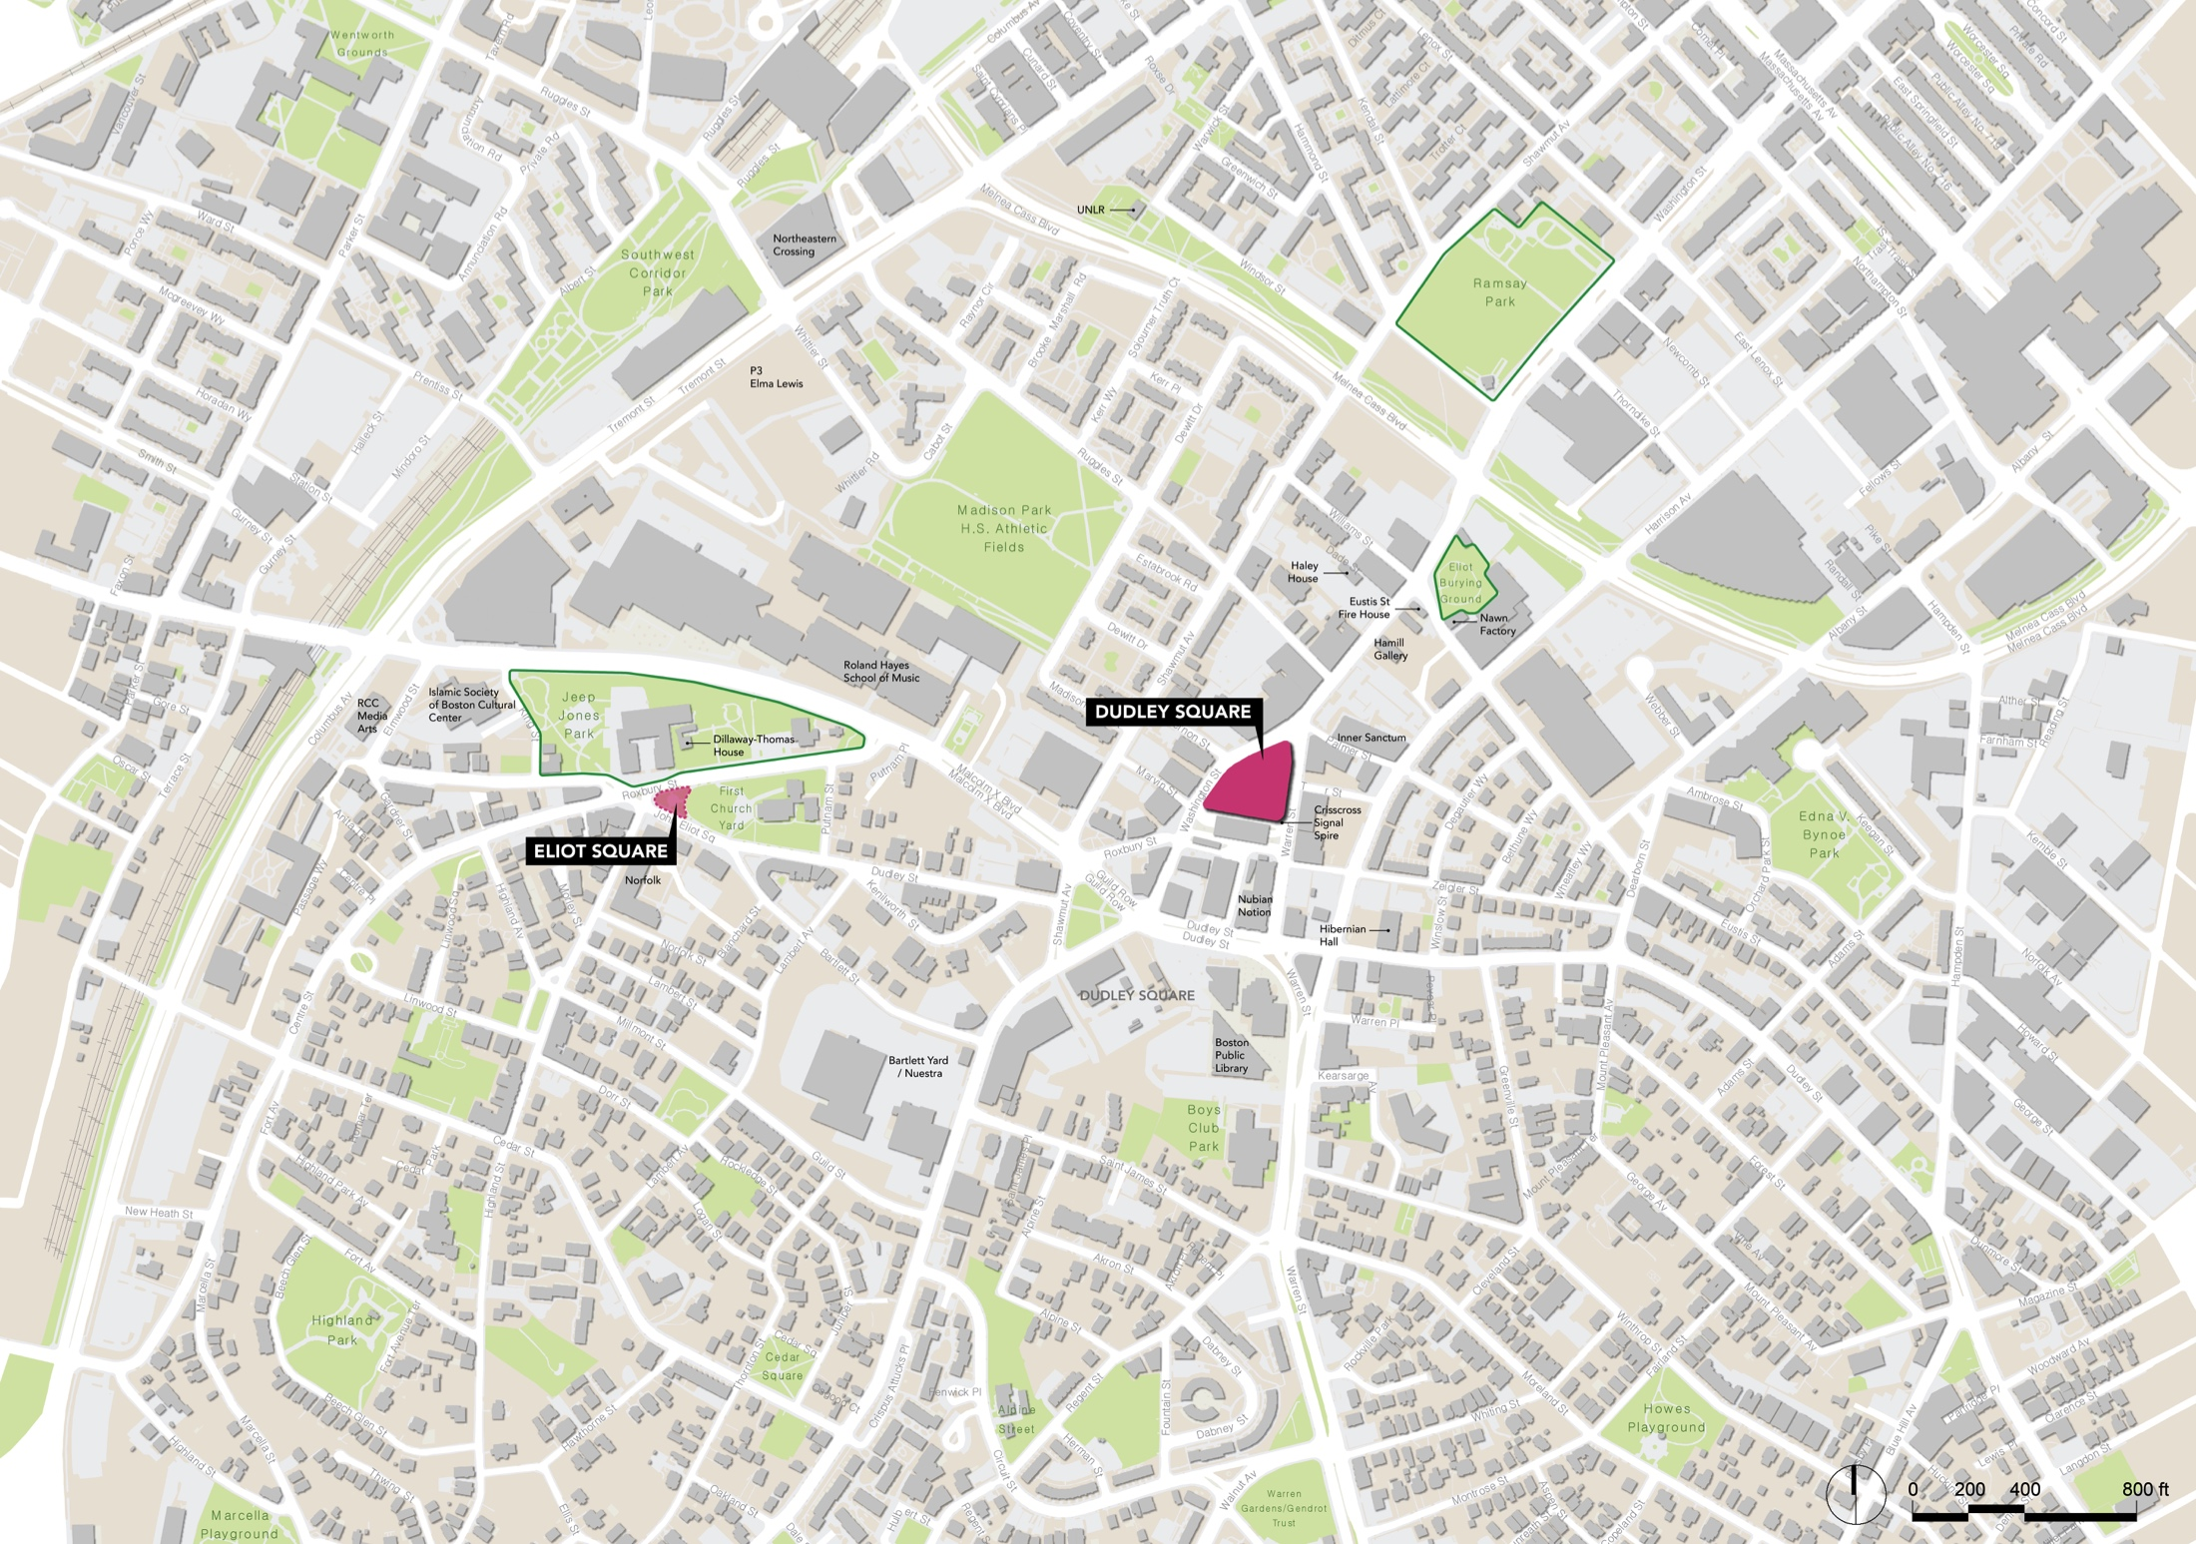
DUDLEY SQUARE-ELIOT SQUARE CULTURAL DISTRICT

Slide 12
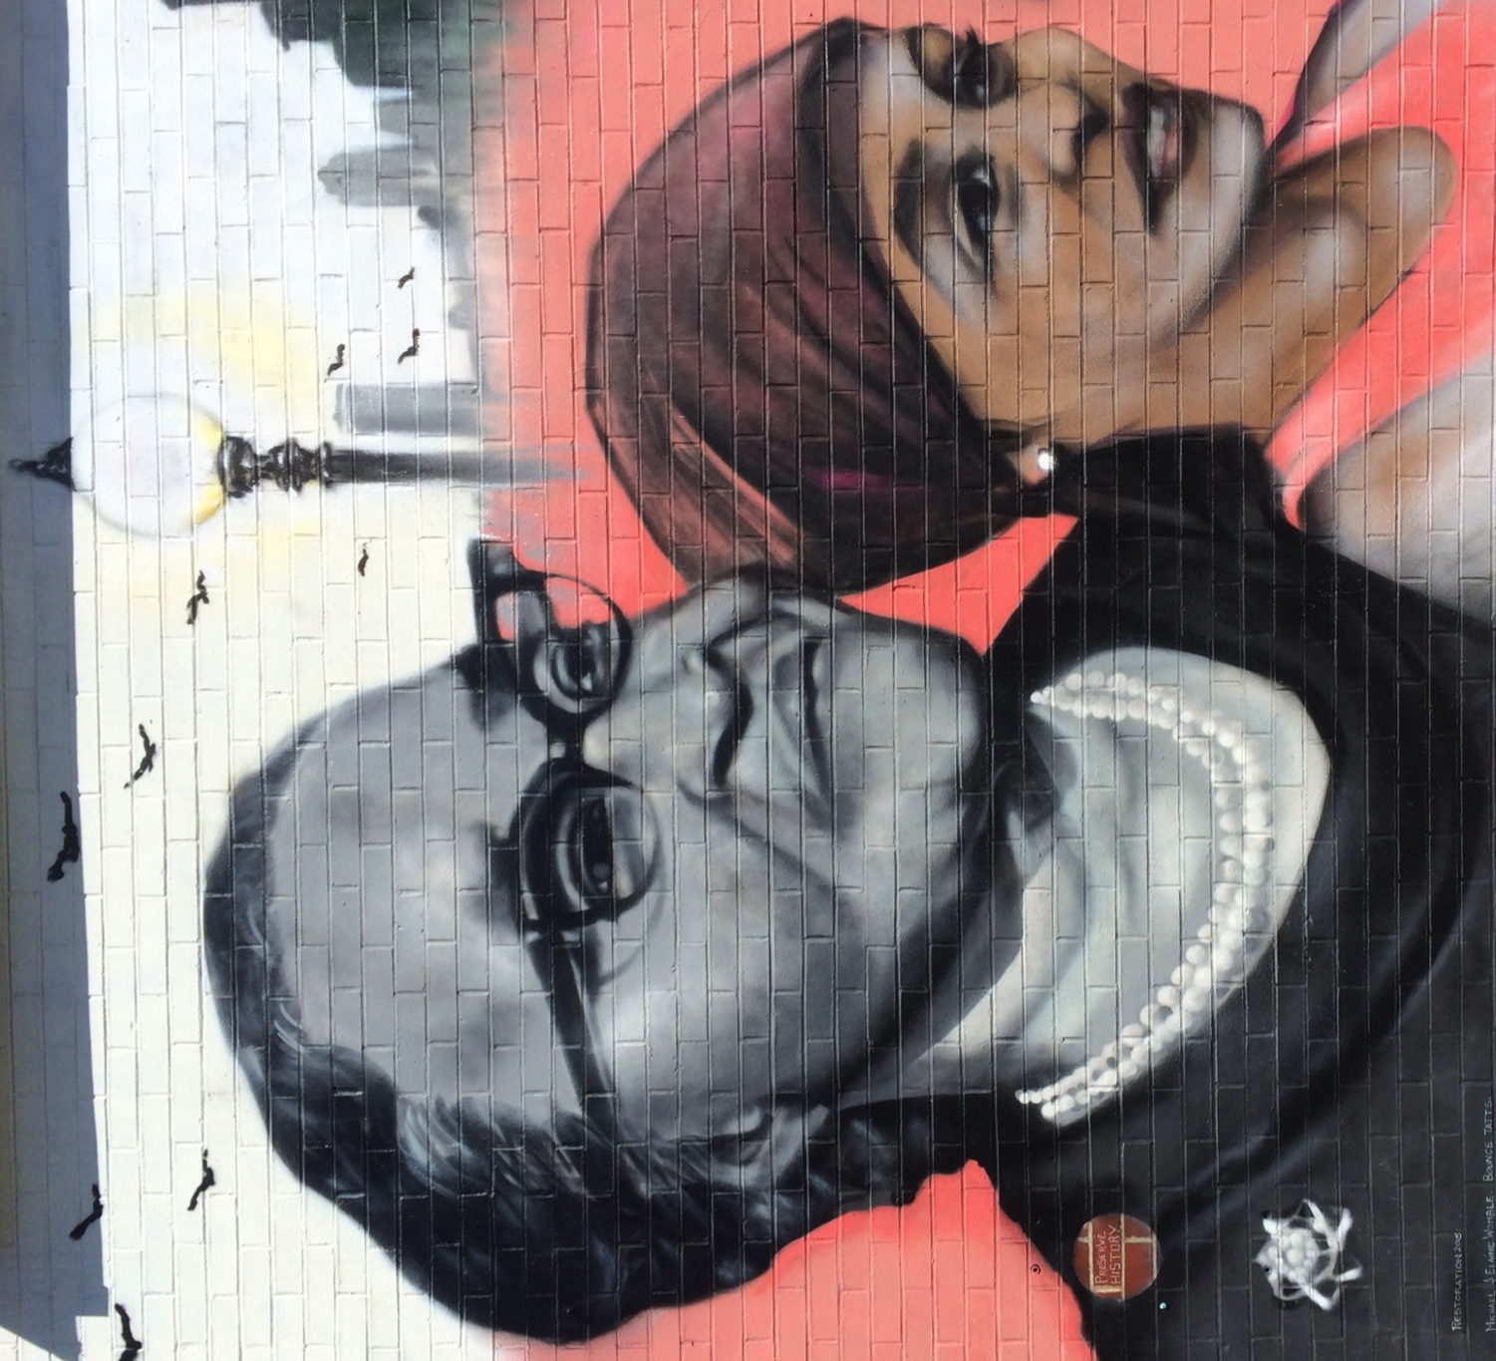
DUDLEY SQUARE-ELIOT SQUARE CULTURAL DISTRICT
Shared Governance
*How do we maintain and sustain the cultural district?
community partnerships
collective brain trust
use of logos to show collaboration
attend advisory meetings
next steps?

Slide 13
(
DUDLEY SQUARE-ELIOT SQUARE CULTURAL DISTRICT
MCC Public/Private Partnership & Management
Outline the plan for overseeing and managing the district and the district partnership.
Notes:
Our Agenda:
-Welcome & Introductions: We know that Byron Rushing will be there and he and other public officials should be formally acknowledged. Also acknowledge Kara Eliot-Ortega from Office of Arts & Culture if she attends. Others that need to be acknowledged? I do like the idea of having everyone quickly say their name and affiliation, if the group is not too large and people don’t start adding more than that.
-A Brief History CR NOTE: I think that we need this to be a bit scripted so we get it right. Maybe here, the focus should be on the cultural district legislation. This was in the RFP and in the grant application. MCC Cultural District Initiative was authorized by an act of the MA state legislature in 2010 and started in April 2011. According to MCC, this program is built on the evidence that a thriving creative sector is one of our Commonwealth's most powerful economic development assets. Since that time, 32 communities across the state have been designated cultural districts including two in Boston: Fenway Cultural District and the Literary Cultural District. In Roxbury, several community stakeholders, including the RNC and Common Thread Coalition and many of you here tonight, have discussed and taken some steps toward seeking this designation for Roxbury. So, I like the idea of talking about it as a relaunch.
Could then add this part now, or find a place for it later: Across the state, cultural districts have brought together organization into collaborative governance structure so they can work together effectively to brand and market their cultural assets and set goals that respond to community need. In August 2015, HH, MPDC, and TACC (orgs that had worked together on the neighborhood component of the Whittier Choice Neighborhood Initiative) started to come together for biweekly conversations.. Initially, we sought to apply for an NEA Our Town grant for place-making activities on Ruggles Street. When that did not move forward, we started to think about the relationship between arts and culture and community planning in Roxbury. In the Fall of 2015, we looked at best practices in cultural districts across the country, conducted interviews with cultural districts in Boston and across the state, and applied for funding. We were fortunate to very quickly receive $25K from The Catalyst Fund (pooled funding from The Boston Foundation, the Kresge Foundation, The Hyams Foundation, and the United Way). Interestingly that The Catalyst Fund was set up to help nonprofits create strong joint ventures. So while tonight you see the logos of HH, MPDC, and TACC attached to this project, we hope that this is the last time you will see just three organizations and this will expand rapidly and that many of you and your organizations will lend your time, energy in resources to this collaborative effort.
-Our Process: I made a four pronged approach: Community Engagement, Cultural Assets and Mapping (and other benchmark data), Identifying Goals, and Shared Governance.
-Next Steps

Slide 14
(
DUDLEY SQUARE-ELIOT SQUARE CULTURAL DISTRICT
How decisions will be made for/by the district;
How often the partnership will meet;
Whether there will be a staff person assigned to administer the cultural district’s goals; and
Who the staff person will report to on a day to day basis.

Slide 15
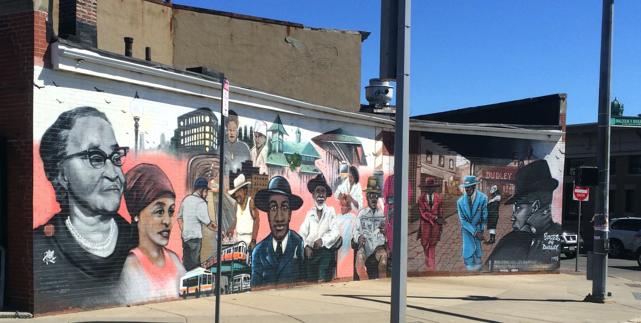
(
DUDLEY SQUARE-ELIOT SQUARE CULTURAL DISTRICT
Governance Structure
Board of Directors: Size? Length of Term?
Executive Steering Committee
Executive Director: Reporting to?
Number of Board Meetings Annually?

Slide 16
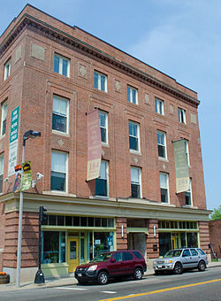
(
DUDLEY SQUARE-ELIOT SQUARE CULTURAL DISTRICT
Committees Chaired by Board Members
Budget/Finance
Marketing
Programming
Event Planning

Slide 17
(
DUDLEY SQUARE-ELIOT SQUARE CULTURAL DISTRICT
Ambassadors/Stakeholders
Project Based Ad Hoc Working Groups
Advisory Committee
Members

Slide 18
(
DUDLEY SQUARE-ELIOT SQUARE CULTURAL DISTRICT
Membership Criteria/Dues
Individuals
Non-profits
For-profits
Students

Slide 19
(
DUDLEY SQUARE-ELIOT SQUARE CULTURAL DISTRICT
Values
Practice Transparency
Build Community Trust
Practice Inclusion

Slide 20
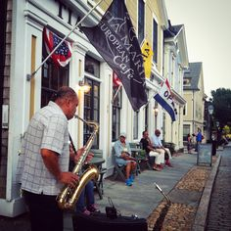
(
DUDLEY SQUARE-ELIOT SQUARE CULTURAL DISTRICT
Samples of Cultural District Governance
The New Bedford Seaport Cultural District
There shall be a Cultural District (CD) Partnership made up of stakeholders from both inside and out of the Cultural District.
Cultural District Executive Committee
There shall be a Executive Committee composed of individuals from organizations representing the arts, culture, history, business, commerce, nonprofits, education, residents and city government.
The Mayor shall appoint the Initial CDEC members. Upon the CDEC being constituted, the CD Steering Committee shall be disbanded.
15 seats
2-year terms

Slide 21
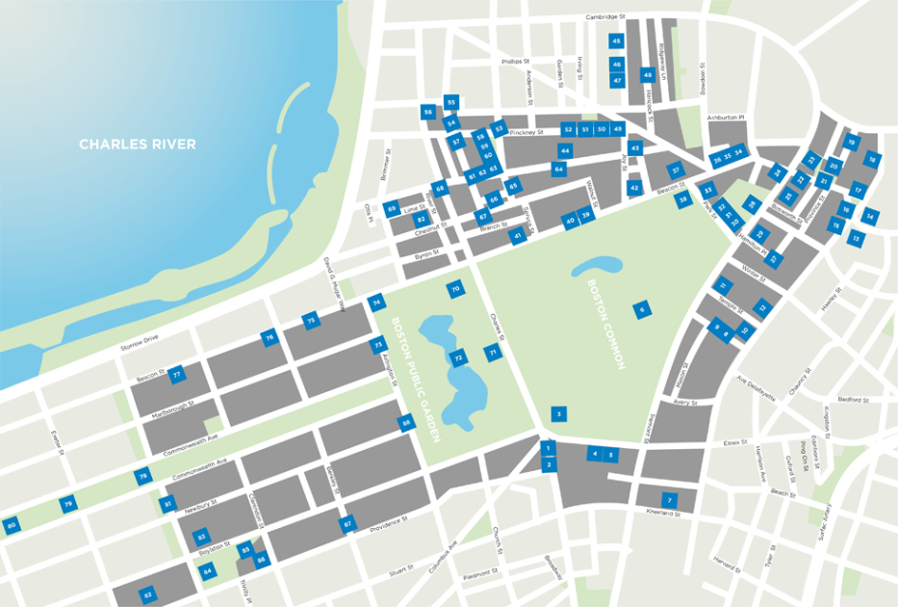
(
DUDLEY SQUARE-ELIOT SQUARE CULTURAL DISTRICT
Samples of Cultural District Governance
Boston Literary District:
10 Executive Partners have oversight of the Boston Literary District. They are “hands on” and make decisions about finances, budget, and programming.
Members come from a variety of literary and academic backgrounds. The new Godfrey Hotel in downtown Boston recently became a partner which will focus on the marketing of the district.
A half-time executive director manages the district daily and collaborates with the partners on strategic direction and budget allocation. She has no vote.
Membership dues are on a sliding scale with dues of $3,200 at the highest level.
Some 40 associate partners currently do no pay dues, but that might soon change to dues of $100-$150 for the event cross promotion that the District provides for them.
Grants
Over the past few pre-designation years, through the formation of a “loose consortium” the District has received grants from MCC and the City of Boston in amounts ranging from $5K to $20K.

Slide 22
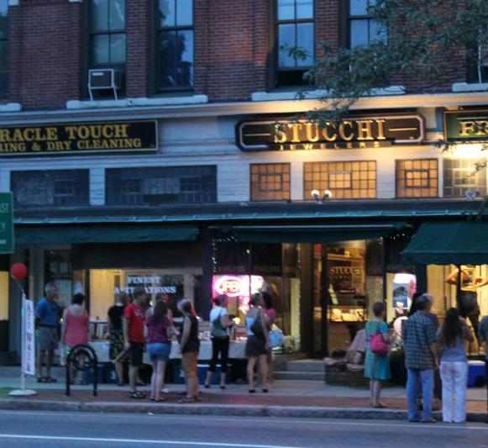
(
DUDLEY SQUARE-ELIOT SQUARE CULTURAL DISTRICT
Samples of Cultural District Governance
Natick Center Cultural District
The Natick Center Associates Board of Directors governs the Natick Center Cultural District. The Associates include business and community leaders.
There are 14 board members, some of whom serve on the executive committee.
One year membership: $50 - $1,200, depending on size of business, corporate or non-profit, or individual
Membership form: https://www.natickcenter.org/user/register
Member benefits:
NCCD member benefits
Networking
Sponsor Events NCCD Helps Sponsor Events
Directory Listings
Marketing and Advertising

Slide 23
(
DUDLEY SQUARE-ELIOT SQUARE CULTURAL DISTRICT
This planning process is being supported by $25,000 from The Catalyst Fund (pooled funding from The Boston Foundation, Boston LISC, The Hyams Foundation, The Kresge Foundation, and the United Way of Massachusetts Bay and Merrimack Valley).
Notes:
Background needs to be changed to white.
So while tonight you see the logos of HH, MPDC, and TACC attached to this project, we hope that this is the last time you will see just three organizations and this will expand rapidly and that many of you and your organizations will lend your time, energy in resources to this collaborative effort.

Slide 24
DUDLEY SQUARE-ELIOT SQUARE CULTURAL DISTRICT
Our Supporters

Slide 25
Get Social with Us! Facebook: Roxbury Cultural District in Dudley Square-Eliot Square Twitter: @roxburyculture
DUDLEY SQUARE-ELIOT SQUARE CULTURAL DISTRICT
Contact Us!
Web: www.roxburyculturaldistrict.org
Phone: 617-427-0046 Email: DECDinfo@gmail.com

